Slide 1

Emotion Detection Using Pre-Trained Transformer Models: BERT
Week 13 Mini Survey Luis Alberto Portilla López

Slide 2
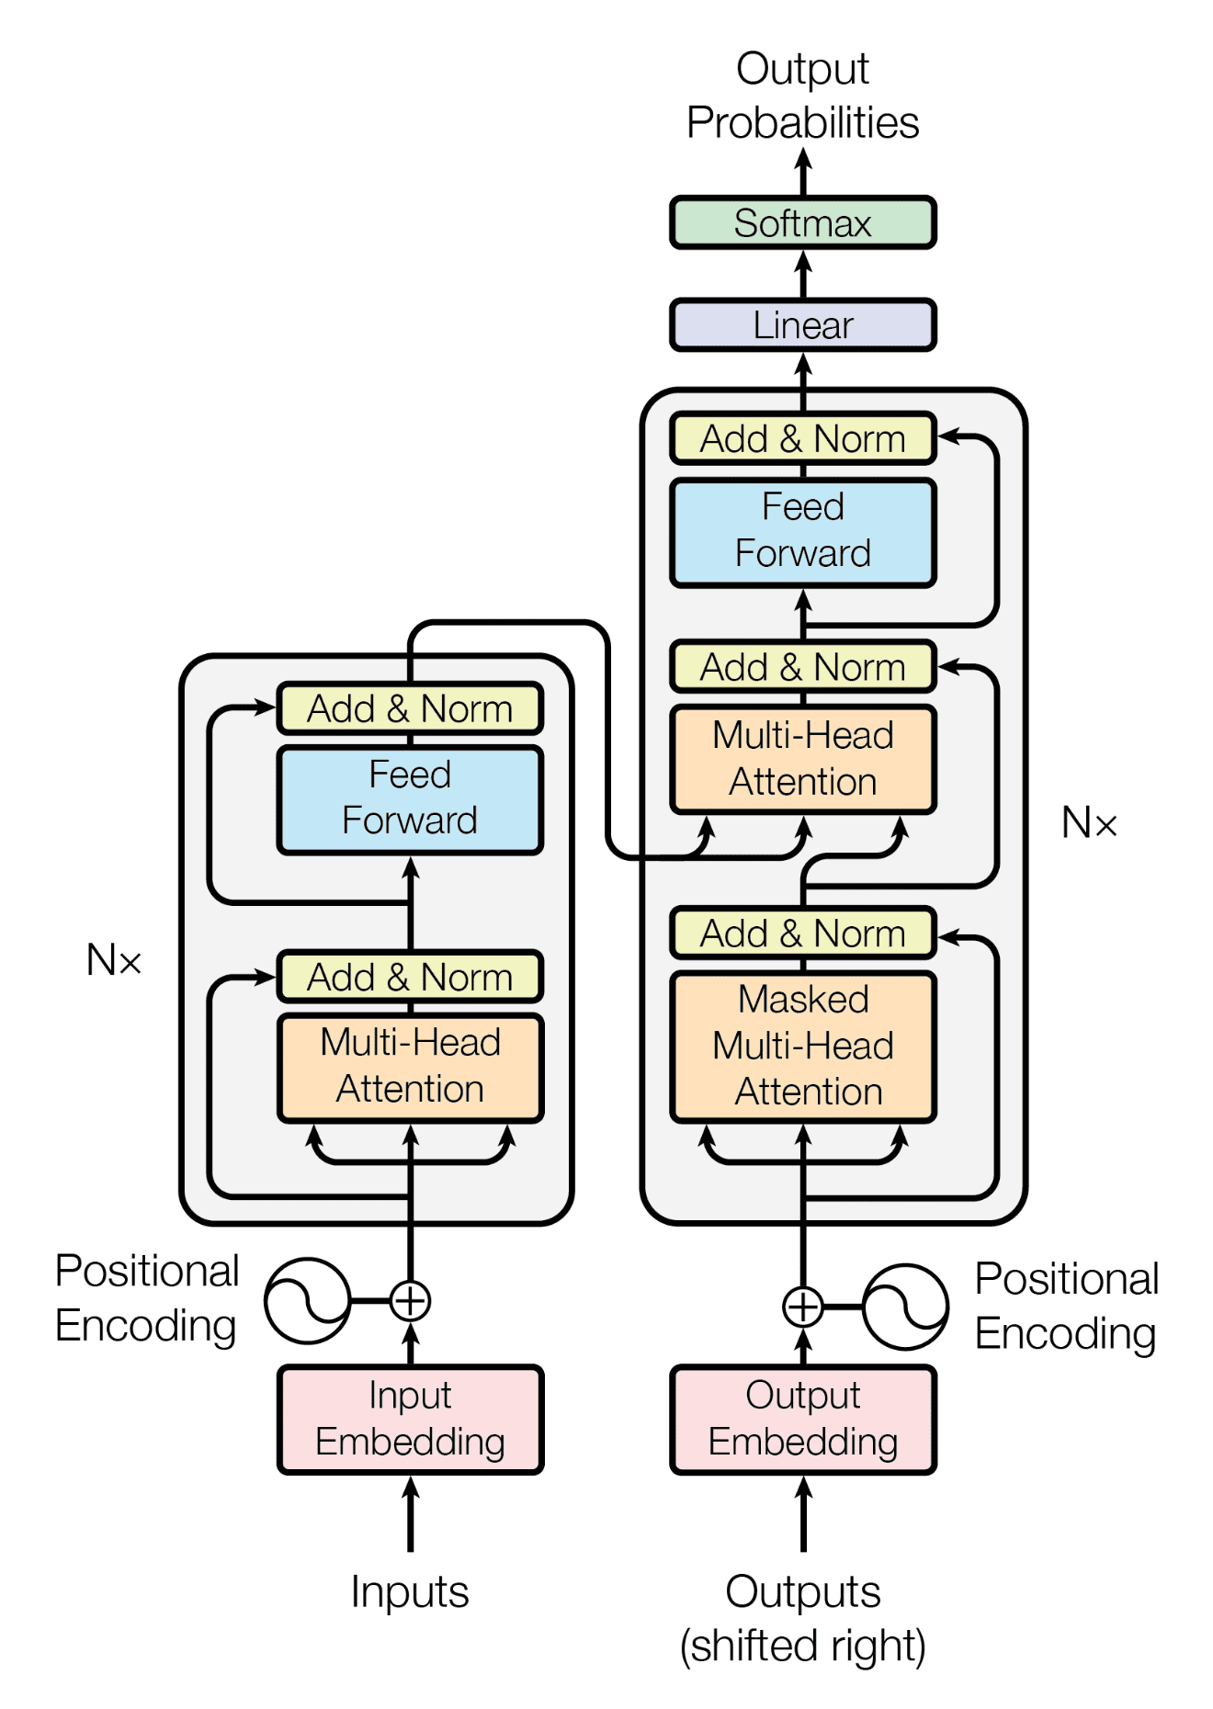
BERT
Bidirectional
Encoder
Representations from
Transformers
language model introduced in October 2018 by researchers at Google.

Slide 3

Search Methodology & Criteria
Keyword Search
Boolean Search
Citation Chaining and Forward Citation
CRITERIA:
• Initial review of abstracts to assess relevance based on the title, publication venue, and year.
• Direct and indirect relevance to the paper being cross-referenced through the abstract.
• Consideration of the number of citations and field-weighted citation impact (fwci), a metric that measures the citation impact of a paper adjusted for disciplinary differences.

Slide 4

Preliminary Terms
Key terms identified during the week:
BERT
• Transformer Architecture
• Masked Language Modeling
• Bidirectional Context

Slide 5


Document Comparison
“A Text Abstraction Summary Model Based on BERT Word Embedding and Reinforcement Learning”
“Does BERT Make Any Sense?
Interpretable Word Sense Disambiguation with Contextualized
Embeddings”
“A Text Abstraction Summary Model Based on BERT Word Embedding and Reinforcement Learning
”

Slide 6
Category | Deep Learning for Sentiment Analysis: Successful Approaches and Future Challenges | Sentiment Analysis for Social Media Data Using Deep Learning Techniques: Review and Approaches | A Text Abstraction Summary Model Based on BERT Word Embedding and Reinforcement Learning
Primary Focus | Exploration of successful deep learning techniques and challenges in sentiment analysis. | Review of deep learning techniques applied to noisy social media data for sentiment analysis. | Development of a hybrid model for text abstraction and summarization.
Evaluation Metrics | Accuracy, F1-score, Precision, Recall. | Accuracy, F1-score. | ROUGE scores for summarization quality.
Datasets Used | IMDB, Yelp, Amazon Reviews. | Twitter, Instagram, Facebook datasets. | CNN/Daily Mail datasets.
Techniques Employed | CNNs, RNNs, and hybrid models. | LSTMs, CNNs, hybrid approaches. | BERT embeddings, reinforcement learning.

Slide 7
Category | Deep Learning for Sentiment Analysis: Successful Approaches and Future Challenges | Sentiment Analysis for Social Media Data Using Deep Learning Techniques: Review and Approaches | A Text Abstraction Summary Model Based on BERT Word Embedding and Reinforcement Learning
Key Contributions | Overview of state-of-the-art deep learning techniques for sentiment analysis. | Focus on handling noise and informal language in social media datasets. | Introducing a novel hybrid approach using contextual embeddings and reinforcement learning.
Novelty | Analysis of emerging challenges such as sarcasm and domain adaptation. | Proposing noise-handling techniques for deep learning in noisy environments. | Combines deep contextual language models with reinforcement learning for summarization tasks.

Slide 8
References
• Citation: Wiedemann, G., Remus, S., Chawla, A., & Biemann, C. (2019). Does BERT Make Any Sense? Interpretable Word Sense Disambiguation with Contextualized Embeddings. Proceedings of the Conference on Computational Linguistics. Universität Hamburg, Germany.
• Citation: Wang, Q., Liu, P., Zhu, Z., Yin, H., Zhang, Q., & Zhang, L. (2019). A Text Abstraction Summary Model Based on BERT Word Embedding and Reinforcement Learning. Applied Sciences, 9(4701), 1-19. doi:10.3390/app9214701.

